Slide 1
Genetic algorithms 2023/2024
Kamil Eliaszuk

Slide 2
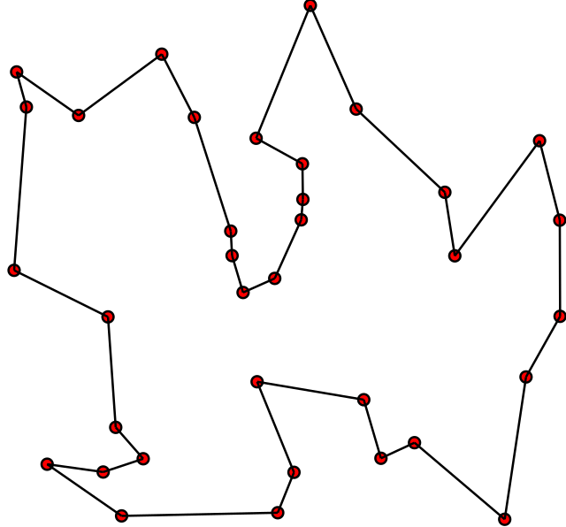
Travelling salesman problem, TSP
Knowing the list of cities and the distances between them, one must find the shortest possible route that connects all the cities, starts and ends at a specified point, and passes through each city only once.
Complexity O(n!)

Slide 3
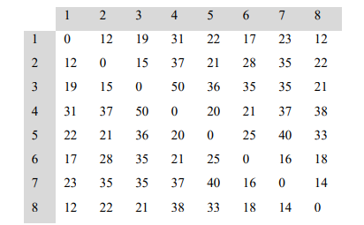
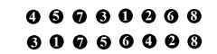
Representation
STSP (symmetrical)

Slide 4
Selection
Fitness function = 1 / total route length
Shorter route -> higher fitness
Roulette method
Tournament method

Slide 5
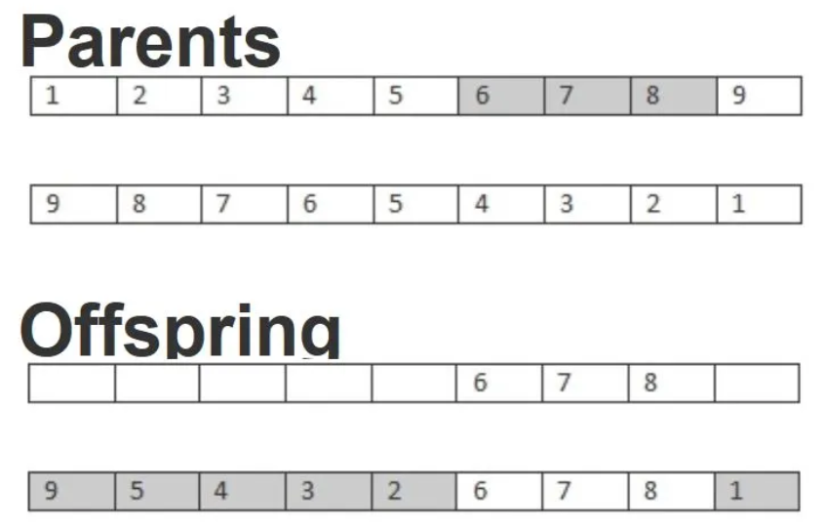
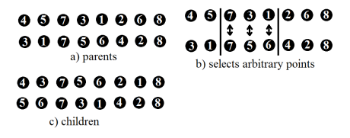
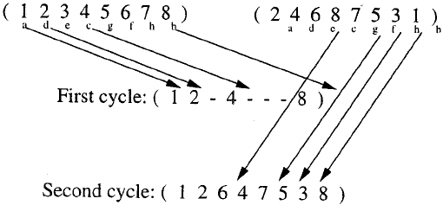
Crossovers (blind)
OX (Ordered Crossover)
PMX (Partially Matched Crossover)
CX (Cycle Crossover)

Slide 6
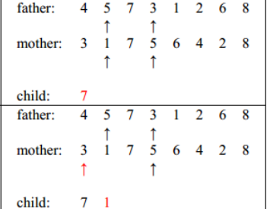
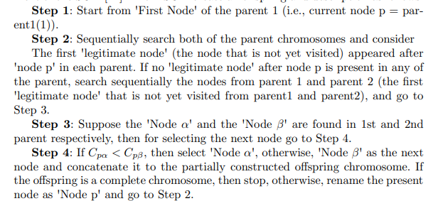
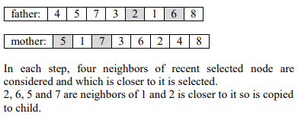
Crossovers (known distance between cities)
UHX (Unnamed
Heuristic Crossover)
MSCX (Modified Sequential
Constructive Crossover)
GX (Greedy Crossover)
https://arxiv.org/pdf/2001.11590.pdf
https://arxiv.org/ftp/arxiv/papers/1504/1504.02590.pdf

Slide 7
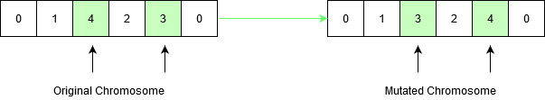
Mutation

Slide 8
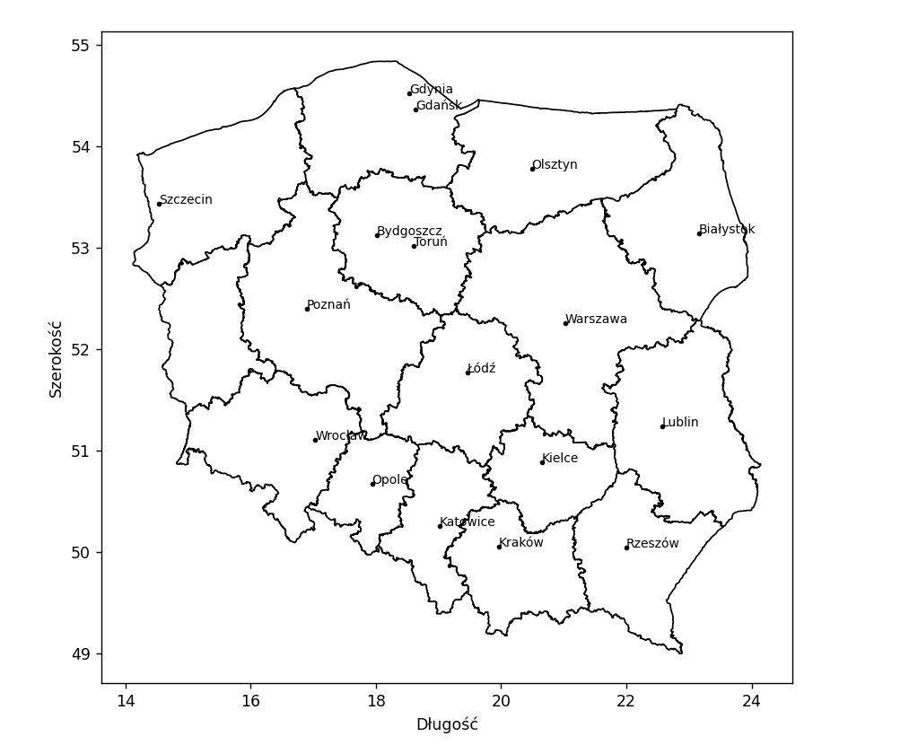
Map of Poland
Cities: http://cybermoon.pl/wiedza/wspolrzedne_polskich_miast.html
Borders:
https://www.geoportal.gov.pl/pl/dane/panstwowy-rejestr-granic-prg/

Slide 9
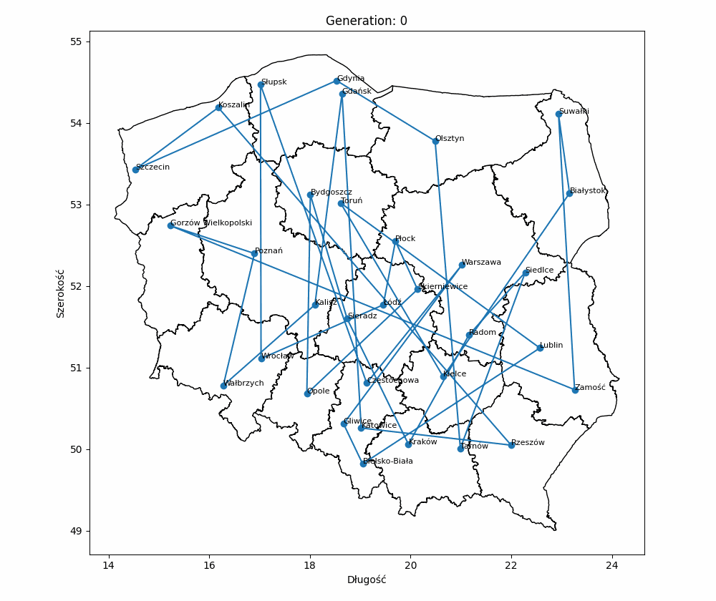
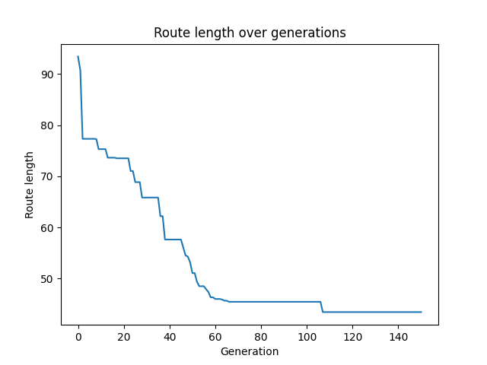
Results - visualization
PMX – 40 cities

Slide 10
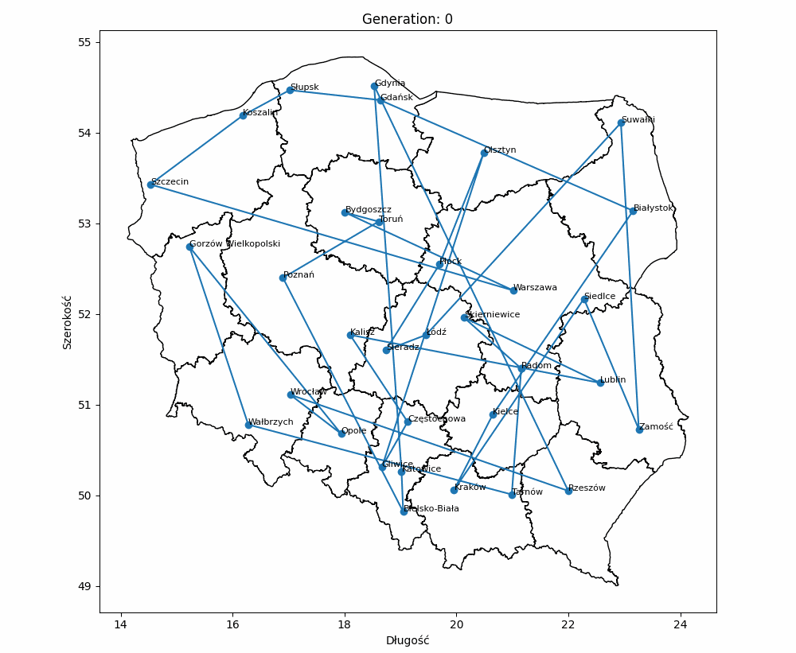
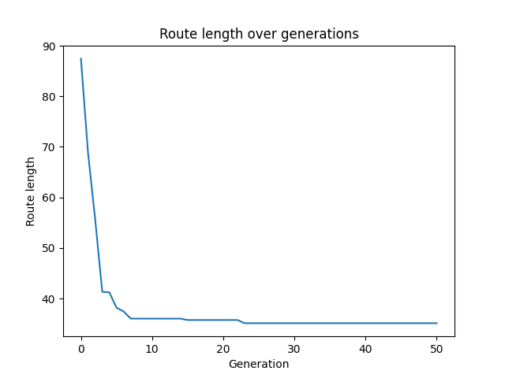
Results - visualization
GX – 40 cities

Slide 11
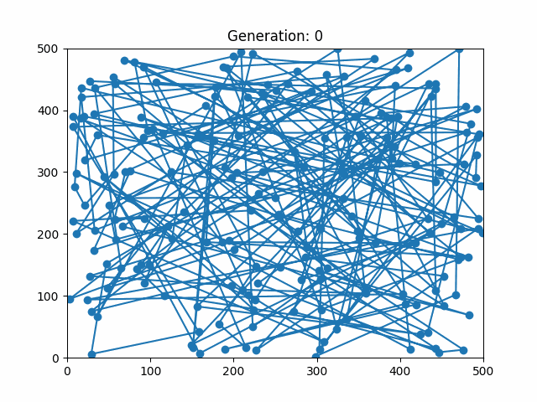
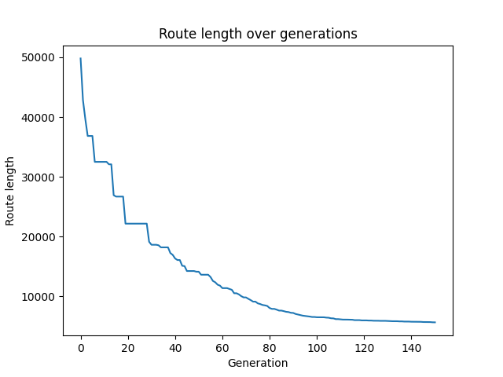
Results - visualization
UHX – 200 cities

Slide 12
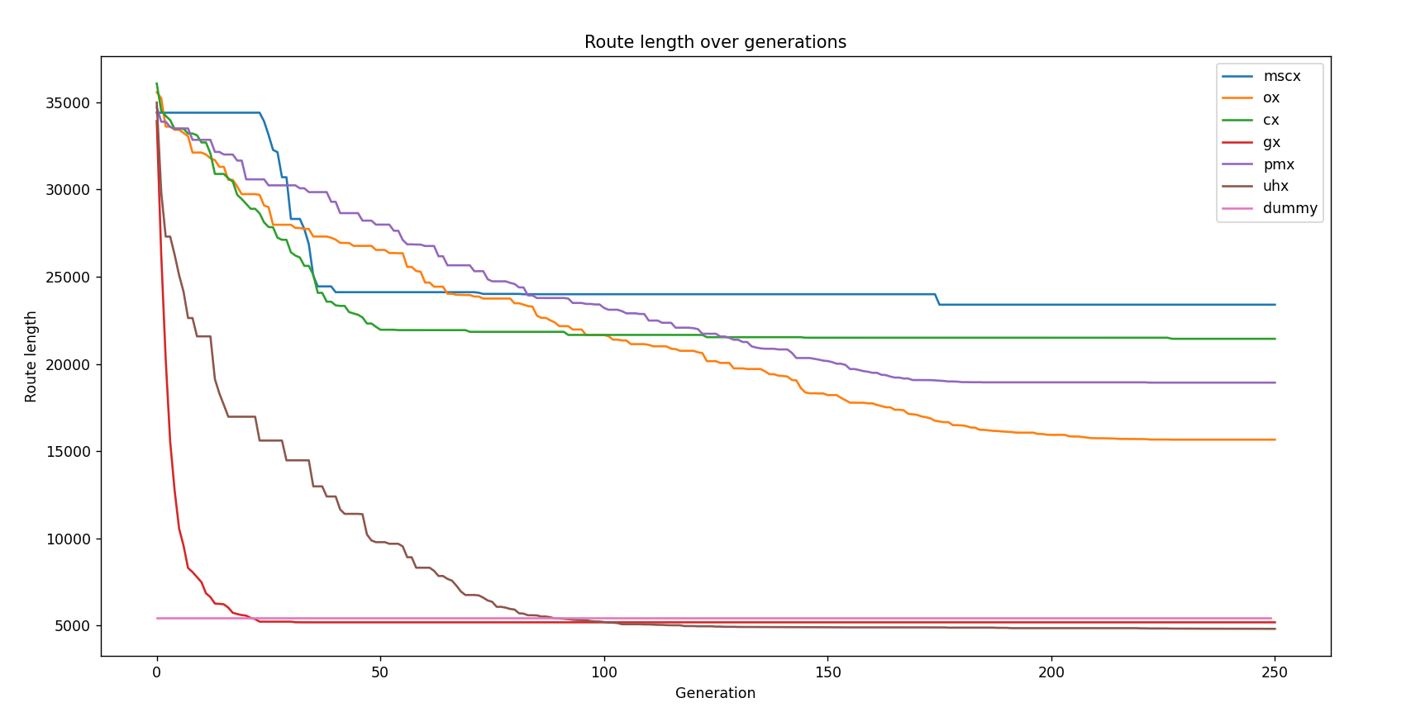
Results – crossover method comparison
Population – 400
Cities – 150
Tournament method,
Mutation – 0.01

Slide 13
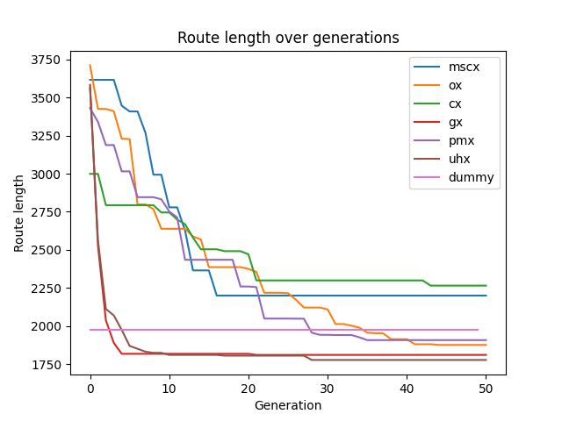
Results – crossover method comparison
Population – 400
Cities – 20
Tournament method,
Mutation – 0.01

Slide 14
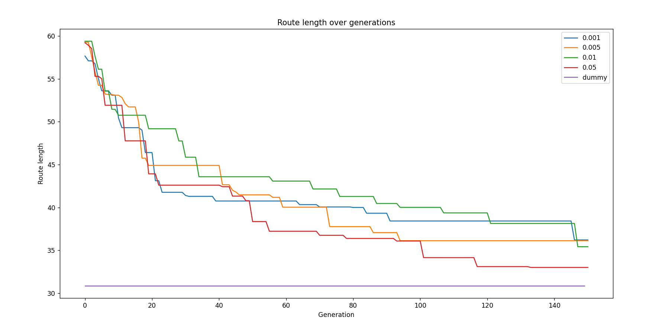
Results – mutation rate comparison
Population – 200
Cities – 25
Roulette method,
Crossover - OX

